Slide 1
CSCE-313 Spring 2016 Final exam Study Guide
Aakash Tyagi CSCE 313 Spring 2016

Slide 2
Final Exam Discussion Outline
Format
Study Guide
Reading Material
Key Concepts
Summary Recap

Slide 3
CSCE 313 SP’15 Final Exam Format
Date: Thursday May 5, 2016, 3-5pm
Venue: Classroom ETB 2005
Duration = 120 minutes
Format: Handwritten answers on exam paper. Answers must be legible and written in the space provided below each question.
Total 60 points distributed over 6 questions. The score will be scaled down to actual allocation for the final grade.
Types of Questions (roughly equally divided among the following categories)
Objective/Multiple-Choice
Problem Solving
Coverage
Process and Thread Synchronization
UNIX I/O
Inter-Process Communication and Signals
Networking, Socket Programming
File Systems
Security (guest lecture L16)

Slide 4
Finals Study Guide - Reading Material Review
Classroom Material: Piazza Resource Section
Guest Lecture: Dr. Philip Ritchey (Security1)
Textbook (Anderson and Dahlin)
Concurrency and Threads: Chapter4: Sections 4.1-4.6
Synchronization: Chapter 5: Sections 5.1-5.3
File System: Chapters 11: Section 11.1, Chapter 13: Sections 13.1-3
Reference Textbook (Advanced Programming in the UNIX Environment; use as needed to buttress material from Slides)
File IO: Chapter 3
Files and Directories: Chapter 4
Signals: Chapter 10 (only the topics covered in class)
Inter-Process Communication: Chapter 15
Network IPC: Chapter 16

Slide 6
Finals Study Guide – Key Concepts
Please make sure you have a firm grasp over these concepts. Past exams are good representation of questions.
Threads: TCB, Thread Operations, Multi-core/Multi-thread Pitfalls
Synchronization: Starvation, Mutex, Critical Section, Atomic Operation, Interrupt Disable, Busy-Wait, Atomic Instructions, Semaphores
Unix I/O: open, close, read, write, file descriptors, file table, vnode table, I/O redirection
Inter-Process Communication: All discussed mechanisms: concept, implementation, pros and cons
Special Files: Pipes and FIFOs
Network Programming: OSI, TCP, UDP, Terminology, Socket Programming concepts, System Calls
File Systems: Unix directory structure, iNode, Links, permissions

Slide 7
Concept Recap and Practice Questions
Key slides from class material are selected for quick recap
Does not mean that the exam will be limited to this material!!

Slide 8
Process and Thread
(Unix) Process
A(int tmp) {
if (tmp<2)
B();
printf(tmp);
}
B() {
C();
}
C() {
A(2);
}
A(1);
…
Process
Memory
threads
Mem.
I/O State
(e.g., file, socket contexts)
…
IO
state
CPU
state
CPU
state
CPU state (PC, SP, registers..)

Slide 9
Thread Execution – Advisory
Cannot make any assumptions about relative speed at which the threads operate (i.e. interleaving is a given)
Program execution can be non-deterministic (scheduler, processor frequencies, etc.)
Compilers can reorder instructions

Slide 10
Key things necessary to make threading work
Sharing of address space is hallmark of threaded code
Need protection mechanism for shared objects
Need to make these protection mechanism “race proof”
Two requirements
Need mechanism to lock shared objects
The lock mechanism itself must be atomically executed
Synchronization: using atomic operations to ensure cooperation between threads
Critical Section: piece of code that only one thread can execute at once
Mutual Exclusion: ensuring that only one thread executes critical section
Lock: prevents someone from doing something
Lock before entering critical section and before accessing shared data
Unlock when leaving, after accessing shared data
Wait if locked

Slide 11
Synchronization – Solutions Palette
Programs
Shared Programs
Higher-level
API
Locks Semaphores Monitors Send/Receive
Hardware
Load/Store Disable Ints Test&Set Comp&Swap
Need Synchronization Primitives to avoid race conditions involving shared objects

Slide 12
Practice Question
Cooperating Threads are advantageous because they allow
a. Facilitate sharing of resources
b. Allow speedup of execution
c. Introduce program modularity
d. All of the above

Slide 13
Practice Question
Consider the following code segment:
pid_t pid;
pid = fork();
if (pid == 0) { /*child process
fork();
threadcreate( . . .);
}
fork();
How many unique processes are created?
Total 6 unique processes are created.
How many unique threads are created?
Total 2 unique threads are created one each by the child and its fork process.
P0
P4
P1
P2
P3
T1
T2
P5

Slide 14
Practice Question
A system with two dual-core processors has four processors available for scheduling. A CPU-intensive application is running on this system. All input is performed at program start-up, when a single ﬁle must be opened. Similarly, all output is performed just before the program terminates, when the program results must be written to a single ﬁle. Between startup and termination, the program is entirely CPUbound. Your task is to improve the performance of this application by multithreading it. The application runs on a system that uses the one-to-one threading model (each user thread maps to a kernel thread).
How many threads will you create to perform the input and output? Explain.
We will create 2 threads to perform input and output respectively since a single file is involved in read and write.
How many threads will you create for the CPU-intensive portion of the application? Explain.
For the CPU intensive operation all cores can be employed simultaneously for a fully parallel operation. Therefore the application must be 4-threaded for 4-way parallel execution.

Slide 15
Practice Question
A concurrent program contains a few updates to a shared variable x, which occur inside critical sections. Variable x is also used in the following portion of code, which is not enclosed in a critical section:
if (x < c)
y = x;
else
y = x + 10;
cout << "x = " << x << " y = " << y << endl;
Does this program have a race condition? If yes, illustrate an example, otherwise explain why not.

Slide 16
Practice Question
Otherwise the control may disappear from this thread and never wake up threads waiting on the condition
Which sequence of steps is correct and why?
Lock a mutex
Change the condition protected by the mutex
Signal threads waiting on the condition
Unlock the mutex
OR
Lock a mutex
Change the condition protected by the mutex
Unlock the mutex
Signal threads waiting on the condition

Slide 17
Inter-Process Communication
OS provides generic mechanisms to communicate
Pipes and Named Pipes (FIFO)
Shared Memory: multiple processes can read/write same physical portion of memory; implicit channel
Message Passing: explicit communication channel provided through send()/receive() system calls
» A system call is required
IPC is, in general, expensive due to the need for system calls

Slide 18
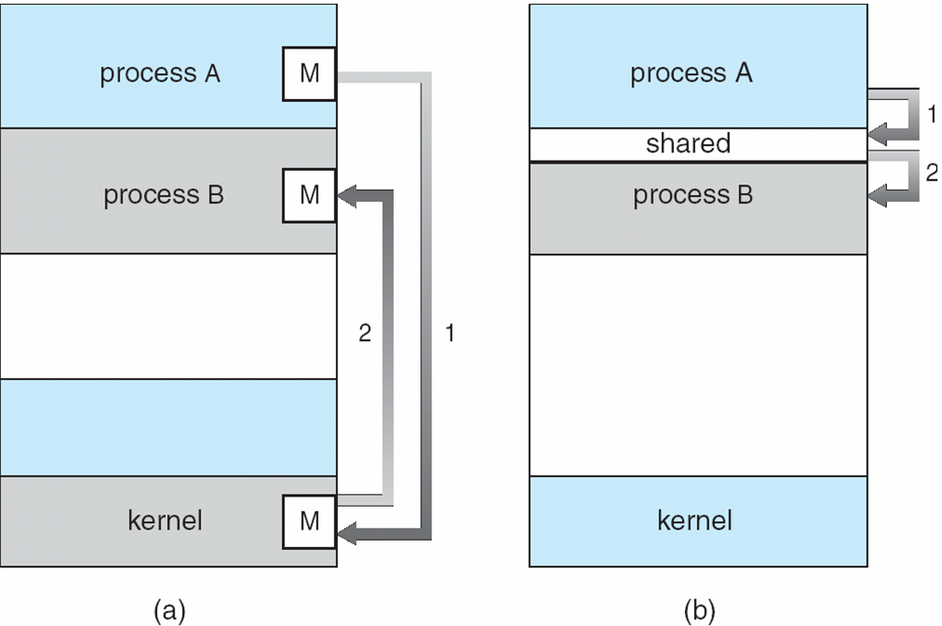
IPC Fundamental Communication Models
Example: pipe, fifo, message, signal
Example: shared memory, memory mapped file

Slide 19


Pipe Creation
int pipe(int filedes[2]);
BEFORE pipe
AFTER pipe
Process has some usual files open
Kernel creates a pipe and sets file descriptors
BEFORE
Shows standard set of file descriptors
AFTER
Shows newly created pipe in the kernel and the two connections to that pipe in the process

Slide 20
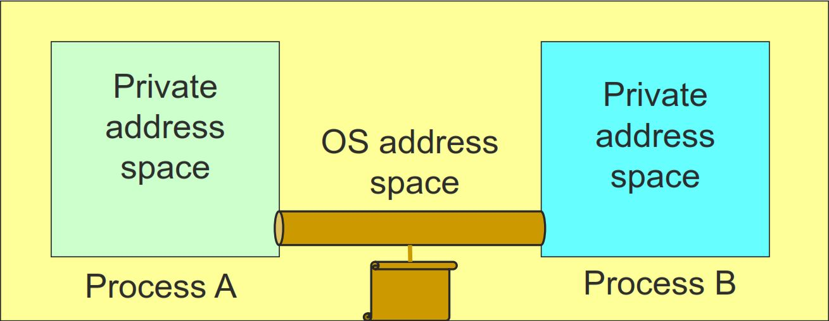
FIFO
A pipe disappears when no process has it open
FIFOS (also called named pipes) are a mechanism that allow for IPC that's similar to using regular files, except that the kernel takes care of synchronizing reads and writes, and
Data is never actually written to disk (instead it is stored in buffers in memory) so the overhead of disk I/O (which is huge!) is avoided.

Slide 21
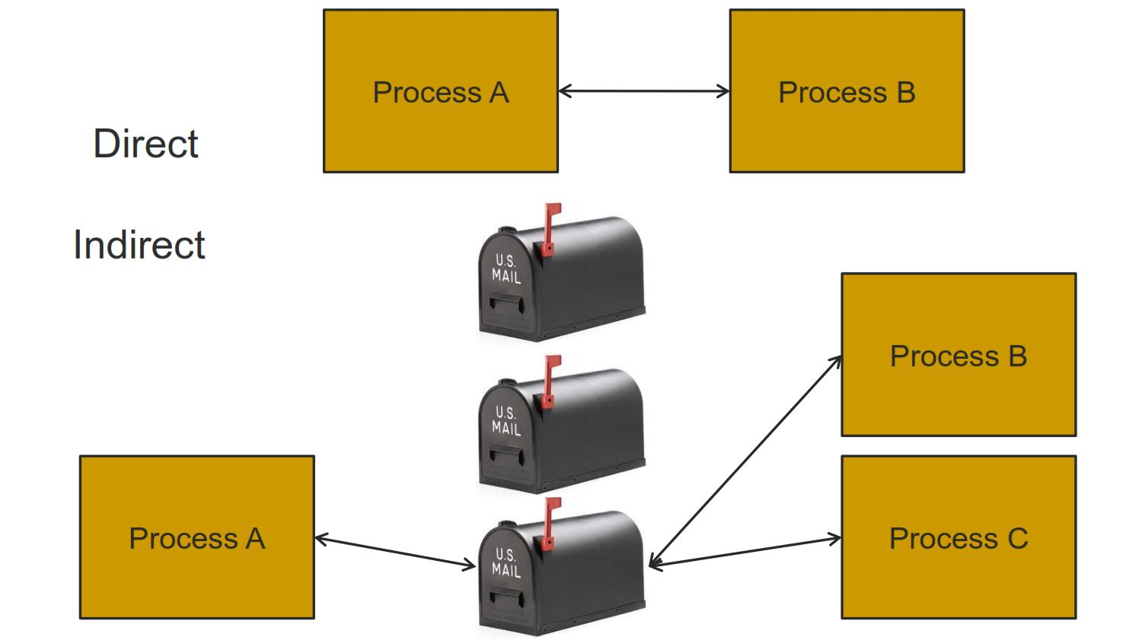
Message Passing

Slide 22
Shared Memory
Process A
Process B
OS Address Space
Processes request the segment
OS maintains the segment
Processes can attach/detach the segment

Slide 23
Practice Questions
When setting up a pipe to a child, the order of system calls is
the parent calls pipe then calls fork
the parent calls fork, then both processes call pipe
Connections to a pipe remain in effect after exec because
the array of open files is part of the process, not the program
the parent adds the pipe to the environment
A pipe can connect two children of the same process if
the parent creates the pipe before creating both children
the parent creates two pipes and connects them
OK
OK
OK

Slide 24
Practice Questions
If two different processes read from the same FIFO,
one will get some data, the other will get the rest
both will read the same data
If two different processes write to the same pipe,
data from one writer may overwrite data from the other one
both sets of messages will get to the reader
Shared memory is faster for communication than pipes because
the kernel stores shared memory segments in the CPU cache
data does not have to be copied from one process to another
OK
OK
OK

Slide 25
Signal
A Signal is a one-word message
A Green Light is a signal, A Referee’s whistle is a signal
These items and events do not contain messages, they are messages!
Each Signal has a numerical code
So when we press CTRL-C key we ask the Kernel to send the interrupt signal to the currently running process
Signals mean to user mode execution what interrupts/exceptions mean to the protected mode execution

Slide 26
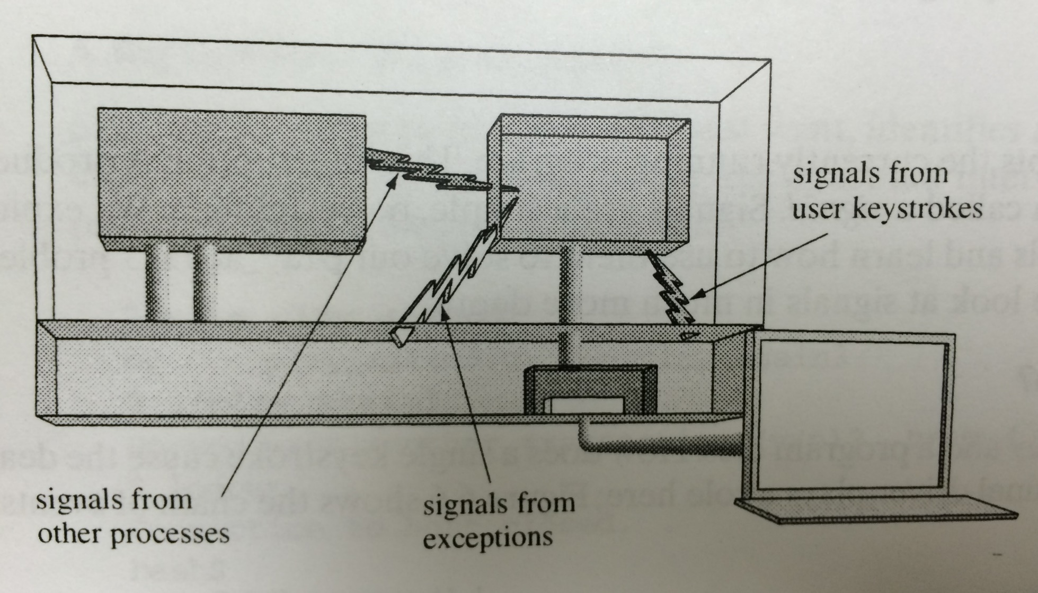
Where do Signals come from?
Taken from: Chapter 6 of “Understanding Unix/Linux Programming” by Bruce Molay

Slide 27
Actions Pertaining to Signals
What can a process tell the Kernel to do about a Signal?
Accept Default, Ignore, Catch
A Signal is “Generated” when ……
event that causes the signal occurs
A Signal is “Delivered” when ……
action for signal is taken

Slide 28
Signals Concept Refresh
A Signal is “Blocked” when …..
it is not allowed to be delivered
signal mask can be used to control ……
set of signals that are prevented from delivery
When the Kernel calls a signal handler on a process, that type of signal is ……
automatically blocked
When a signal handler returns, the blocked signal type is …….
automatically unblocked

Slide 29

Multiple Signals Handling….Process
A Process receives multiple signals
Does the handler stay in effect after a signal arrives?
What happens if a SIGY arrives while the process is in SIGX handler?
What happens if a second SIGX arrives while the process is still in SIGX handler? Or a third SIGX?
What happens if a signal arrives while the program is blocking on input?
SIGINT
SIGINT Handler
SIGALRM
SIGQUIT Handler
SIGQUIT
SIGALRM Handler

Slide 30

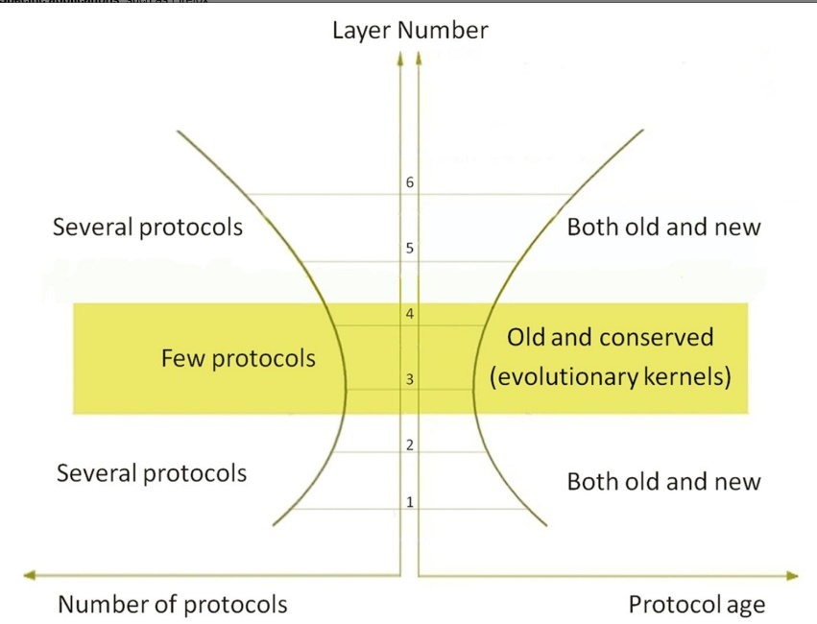
Internet Hourglass Architecture
Email, Web, ssh,...
TCP, UDP, …
IP
Source: GATECH Internet Hourglass Architecture
From top to bottom, the Internet architecture consists of six layers:
Specific applications, such as Firefox;
Application protocols, such as Hypertext Transfer Protocol (HTTP);
Transport protocols, such as Transmission Control Protocol (TCP);
Network protocols, such as Internet Protocol (IP);
Data-link protocols, such as Ethernet; and
Physical layer protocols, such as DSL.
Layers near the top and bottom contain many items, called protocols.
The central transport layer contains two protocols
and the network layer contains only one, creating an hourglass architecture.
Ethernet, WiFi,
3G, bluetooth,...
30

Slide 31
Transferring Data Over an internet
Host A
Host B
client
server
(1)
data
(8)
data
protocol
software
protocol
software
internet packet
(2)
data
PH
FH1
(7)
data
PH
FH2
LAN1 frame
LAN1
adapter
LAN2
adapter
Router
(3)
data
PH
FH1
(6)
data
PH
FH2
LAN1
adapter
LAN2
adapter
LAN1
LAN2 frame
LAN2
(4)
data
PH
FH1
(5)
data
PH
FH2
protocol
software
Cox
Networking
31

Slide 32
Organization of an Internet Application
Internet client
Internet server
Client
User code
Server
Sockets interface
(system calls)
TCP/IP
Kernel code
TCP/IP
Hardware interface
(interrupts)
Network
adapter
Hardware
and firmware
Network
adapter
Global IP Internet
Cox
Networking
32

Slide 33
Putting it all Together: Anatomy of an Internet Connection
Client socket address
128.2.194.242:51213
Server socket address
208.216.181.15:80
Client
Server
(port 80)
Connection socket pair
(128.2.194.242:51213, 208.216.181.15:80)
Client host address
128.2.194.242
Server host address
208.216.181.15
Cox
Networking
33

Slide 34
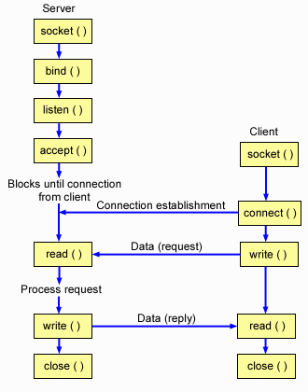
A TCP Client-Server Interaction

Slide 35
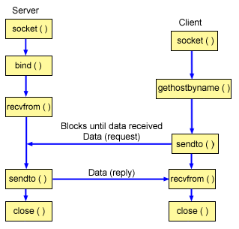
A UDP Client-Server Interaction

Slide 36
So what about a “real” file system
file_number

Slide 37
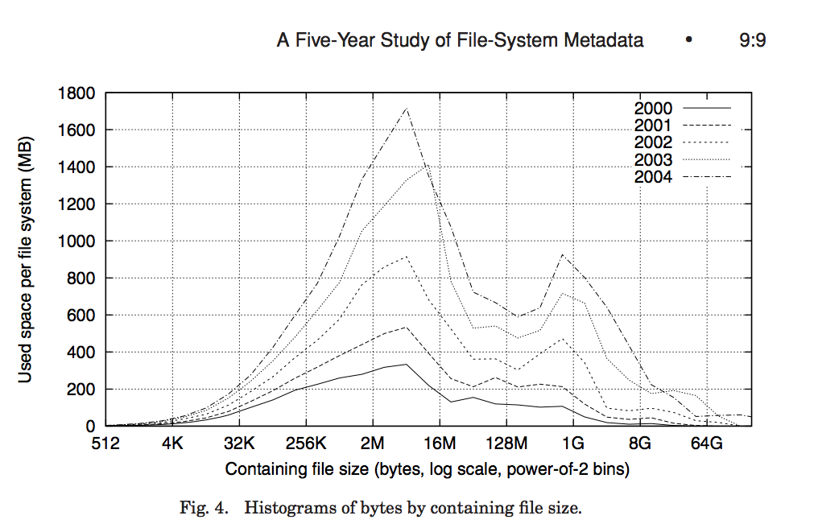
FFS: Data Storage
Large files: 1,2,3 level indirect pointers
Indirect pointers
- point to a disk block
containing only pointers
- eg. 4 KB blocks => 1024 pointers
=> 4 MB @ level 2
=> 4 GB @ level 3
=> 4 TB @ level 4
48 KB
+4 MB
+4 GB
+4 TB

Slide 38
Hard Links
directory entry in /dirA
directory entry in /dirB
inode
name
inode
name
12345
name1
12345
name2
inode 12345
block 23567
…
“some text in the file…”
2
1
…
23567
shell command
ln /dirA/name1 /dirB/name2
is typically implemented using the link system call:
#include <stdio.h>
#include<unistd.h>
if (link(“/dirA/name1”, “/dirB/name2”) == -1)
perror(“failed to make new link in /dirB”);
…
Notes:
Create an entry called “name2” in “dirB” containing a pointer to the same inode as “/dirA/name1”

Slide 39
Symbolic (Soft) Links
directory entry in /dirA
directory entry in /dirB
inode
name
inode
name
12345
name1
13579
name2
Only count
hard links!
inode 12345
inode 13579
block 23567
block 3546
…
“some text in the file…”
…
“/dirA/name1”
1
1
…
…
23567
3546
shell command
ln -s /dirA/name1 /dirB/name2
is typically implemented using the link system call:
#include <stdio.h>
#include<unistd.h>
if (symlink(“/dirA/name1”, “/dirB/name2”) == -1)
perror(“failed to create symbolic link in /dirB”);
…
…
Notes:
“symbolic link” is basically a file containing the name of another file.

Slide 40
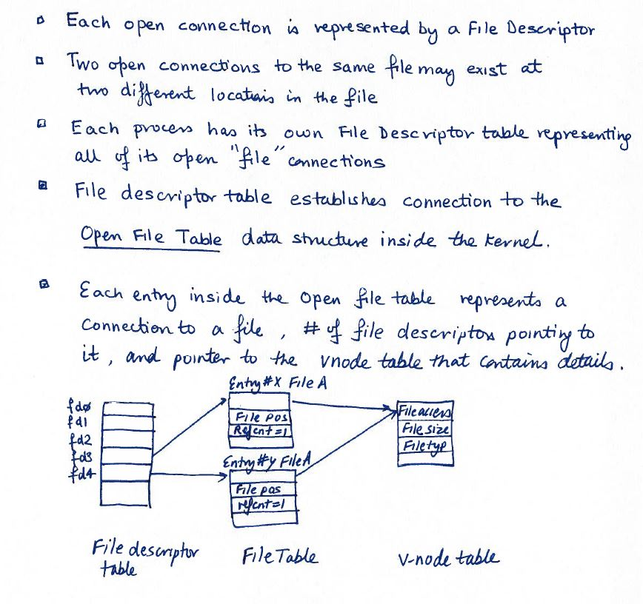
Recap: File Connections

Slide 41
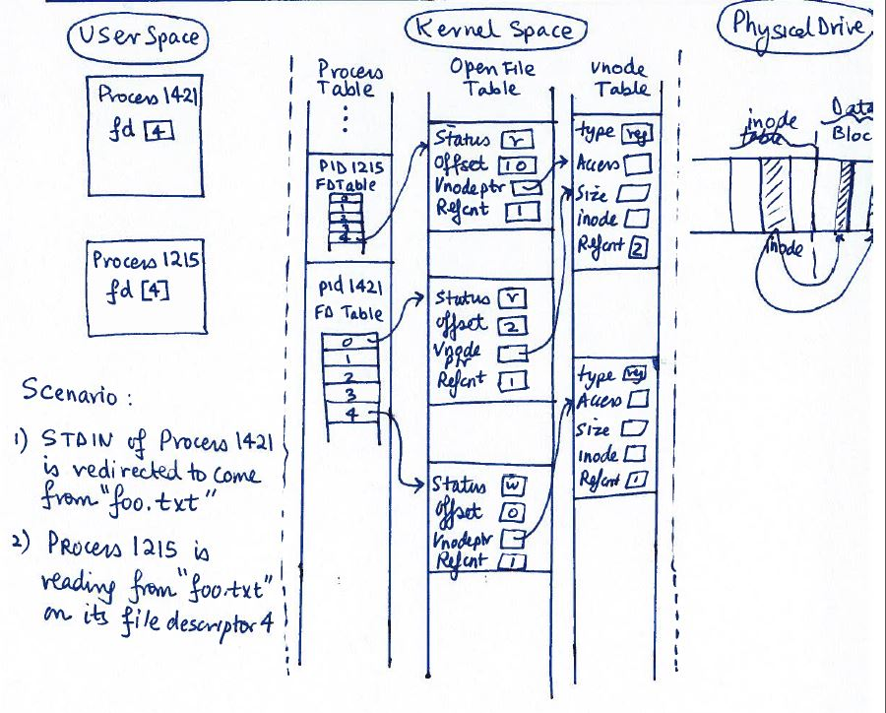
Big Picture tying User Space, Kernel Space, and Disk File

